Slide 1
Introduction to philosophy Lecture 5
PHI1101
Dr. Lucas Scripter
Lecturer in General Education
School of Humanities and Social Sciences
Chinese University of Hong Kong, Shenzhen

Slide 2

Three ways of conceiving of philosophy
Philosophy as a Way of Life
Philosophy as the Foundation of the Sciences
Philosophy as Conceptual Analysis

Slide 3
REVIEW

Slide 4


Philosophy as a way of life 1
Pierre Hadot’s idea of “philosophy as a way of life” includes four key aspects:
1. Goal of Philosophy:
Self-Transformation
2. Setting of Philosophy:
Practiced in a Group or School
3. Psychological Assumption:
Philosophical training can lead to a change in human beings.
4. Metaphysical Context:
Philosophers should cultivate ‘cosmic consciousness’

Slide 5
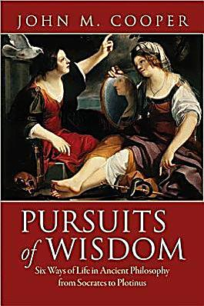
Philosophy as way of life 2
John M. Cooper (2012) has also argued that ancient philosophy is best understood as a ‘way of life’, but he emphasizes something different than Hadot.
“To live a life of philosophy is to live committed to following philosophical reason wherever it may lead. The promise is that by doing so—but only by doing so—one will achieve the best possible human life” (p. 18)
5. Living according to Reason
Conducing one’s life according to reason (not custom or religion)

Slide 6
Hellenistic schools
Plato’s Academy
Aristotle’s Lyceum
The Cynics
The Skeptics
The Epicureans
The Stoics

Slide 7
Comparison: Stoic & epicurean cosmologies
Epicurean
Atomistic
Stoic
Organic
Vitalistic
Mechanical
Infinite Worlds
One World-Soul
Accidental
Purposeful
Pantheistic
Functionally Atheistic
(see Robin, p. 341; Hadot 2004, pp. 129-130)

Slide 8
Comparison: three ancient views of happiness
Epicurean
Happiness: Pleasure.
Aristotelian
Happiness: Virtue & External Goods
Virtue as the realization of reason in contemplation and controlling our irrational appetites.
Stoic
Happiness: Virtue alone.
Virtue is understood as rational self-government—forming the right judgments.
Lasting pleasure is to be found in stable (non-movement based) sources, both psychic and material
Human happiness is vulnerable to luck and external happenings.
Human happiness is always within our grasp and is immune to luck.
(see Cooper, pp. 191-2, 203ff)

Slide 9
What is existentialism?

Slide 10
Existentialism: the 4 Major figures
Soren Kierkegaard (1813-1855)
Friedrich Nietzsche (1844-1900)
Jean-Paul Sartre (1905-1980)
Martin Heidegger (1889-1976)

Slide 11
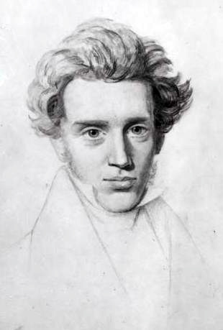
kierkegaard
Argued that there a different ‘spheres of existence’ in which individuals exist (aesthetic; ethical; religious).
Criticized Christendom or the Christian Danish society of his day for its passionless practice of religion.
Interpreted the Christian religion as individuating—calling each individual to make a decision for him/herself alone.
Argued that becoming a Christian required a ‘leap of faith’ (fideism).

Slide 12
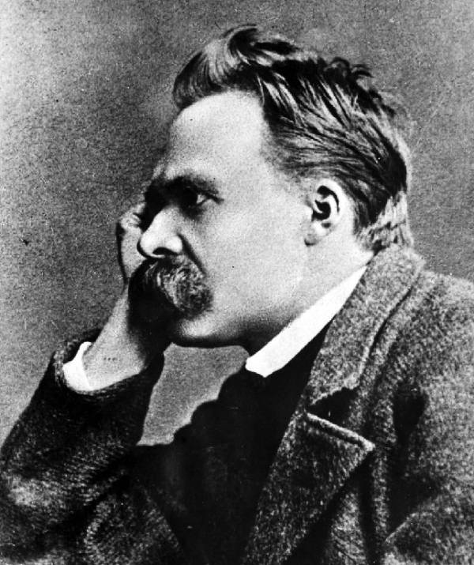
Nietzsche
Praised Greek culture and saw Socrates as the beginning of the decline of Western culture.
Criticized Judeo-Christian morality as a ‘slave morality’ rooted in ressentiment. Against this so-called ‘herd morality’ , he praised an ethic of nobility—of powerful, independent individuals.
Übermensch—Nietzsche’s idea of the type of creature toward which humanity should aspire.
Friedrich Nietzsche (1844-1900)

Slide 13
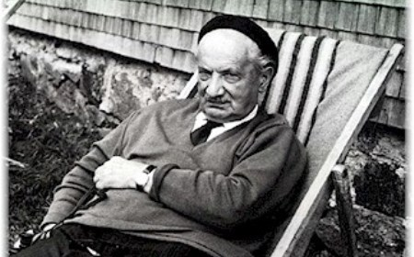
Heidegger
His major early work Being and Time (Sein und Zeit) raised the question of the ‘meaning of being’.
Analyzed the existential structures of human beings or what he called Dasein.
Argued that an individual's awareness of his or her own death could jolt her out of a sleepy going-along-with the crowd and enable her to live an authentic existence.
Martin Heidegger (1889-1976)

Slide 14
Sartrean existentialism

Slide 15
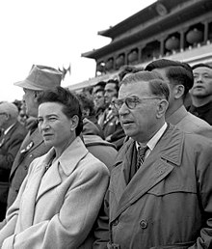
Sartre’s life
Jean Paul Sartre (1905-1980) is perhaps the philosopher most closely associated with ‘existentialism’
Born into an affluent Bourgeois family whose extended relatives included Albert Schweitzer.
Attended the Ecole Normale
Long-time partner with French existentialist Simone De Beauvoir
Former prisoner of war in Germany; involved in French underground during the occupation.

Slide 16
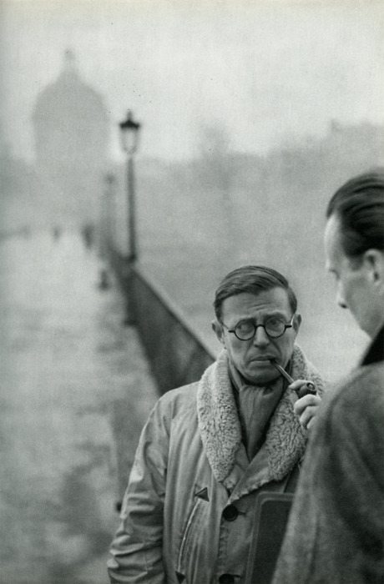
Sartre’s Major Works
Transcendence of the Ego (1937)
Nausea (1938)
Sketch for a Theory of Emotions (1939)
The Imaginary (1940)
Being and Nothingness (1943)
No Exit (1944)
Existentialism is a Humanism (1946)
Critique of Dialectical Reason (1960, 1985)

Slide 17
Sartre’s Phenomenology

Slide 18
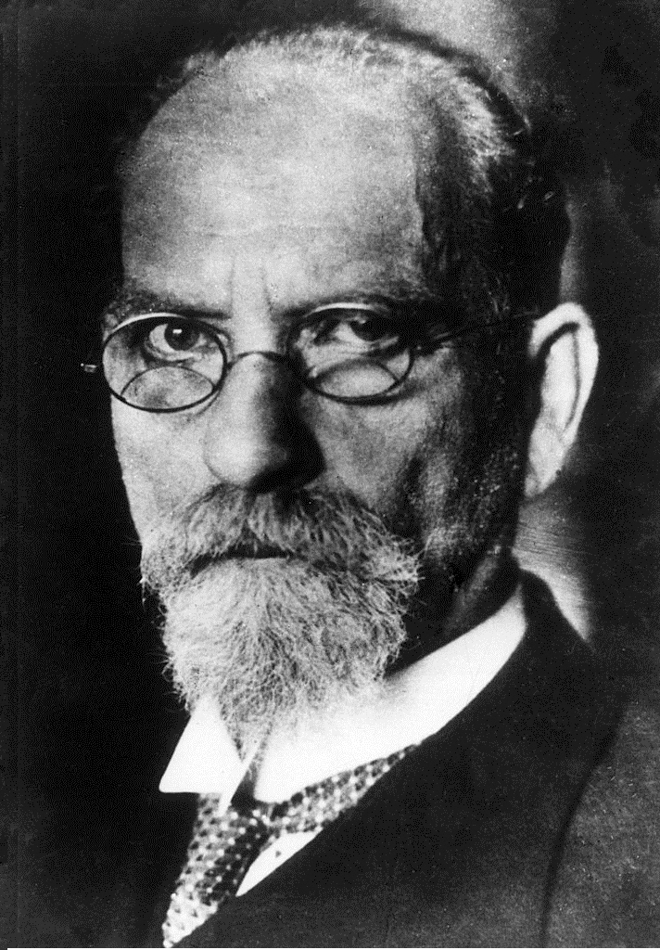
Background: Husserl’s phenomenology
Central Ideas of Phenomenology:
“To the things themselves”
Intentionality: all consciousness is consciousness of something—it is directed at an object.
Phenomenological Reduction: Phenomenology brackets the question of the existence of the world beyond consciousness—it focuses just on how things appear to us.
Phenomenology adopts a descriptive methodology. It argues by providing a rich description of how certain phenomena show themselves to consciousness.
Edmund Husserl (1859-1938)

Slide 19
Phenomenological existentialism
phenomenology
existentialism

Slide 20

Discussion question:
Think about your self.
What are you thinking about?
?

Slide 21
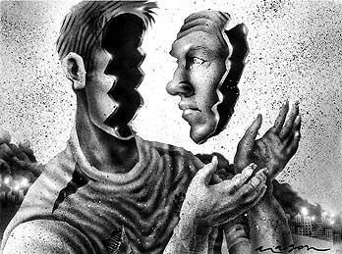
pre-reflective consciousness
Sartre distinguishes Reflective Consciousness from Pre-Reflective Consciousness.
In our pre-reflective consciousness, Sartre thinks that our intentionality directed at objects is accompanied by an implicit awareness of one’s self (what Sartre calls “non-positional” awareness)
Sartre is trying to draw our attention to our self-awareness that is implicitly present in all other transcendent acts of consciousness.
Example: awareness in counting (BN2, p 13)

Slide 22

consciousness
“All consciousness is consciousness of something. This means that transcendence is the constitutive structure of consciousness; that is, that consciousness is born supported by a being which is not itself.” (BN2, p. 23)

Slide 23


Two kinds of Being
Being-in-itself (en-soi)
Being-for-itself (pour-soi)
Non-self-transcending
Example: things, e.g., chairs, books, trees, etc.
Self-transcending
Example: consciousness, which necessarily is consciousness of something.
“The For-itself…is nothing but the pure nihilation of the In-itself; it is like a hole in being at the heart of Being.” (BN2, pp. 785-6)

Slide 24
Bad Faith

Slide 25

The Lie
True
“The essence of the lie implies in fact that the liar actually is in complete possession of the truth which he is hiding. A man does not lie about what he is ignorant of; he does not lie when he spreads an error of which he himself is the dupe; he does not lie when he is mistaken. The ideal case of the liar would be a cynical consciousness, affirming truth within himself, denying it in his words, and denying the denial to himself.” (BN, p. 370, italics mine)
“The liar intends to deceive and he does not seek to hide this intention from himself nor to disguise the translucency of consciousness” (BN, p. 371)
False

Slide 26
The Lie
Presuppositions for the Lie:
“The Lie…presupposes my existence, the existence of the Other, my existence for the Other, and the existence of the Other for me.” (BN, p. 371)
Ontological Duality as a condition for the lie:
“It is sufficient that an overall opacity hide his intentions from the Other; it is sufficient that the Other can take the lie for truth. By the lie consciousness affirms that it exists by nature as hidden from the Other; it utilizes for its own profit the ontological duality of myself and myself in the eyes of the Other.” (BN, p. 372)

Slide 27
Discussion Question:
Is it possible to lie to oneself? Is self-deception possible?
True
False

Slide 28

The difficulty with ‘bad faith’
“Bad Faith” is a kind of lie to oneself. This means that I both know and don’t know:
“what changes everything is the fact that in bad faith it is from myself that I am hiding the truth. Thus the duality of the deceiver and the deceived does not exist here. Bad faith on the contrary implies in essence the unity of a single consciousness.” (BN, p. 372)
“I must know what the truth is exactly in order to conceal it more carefully—and this not at two different moments, which at a pinch would allow us to re-establish a semblance of duality—but in the unitary structure of a single project.” (BN, p. 372)

Slide 29

Example 1: hand-Holding
Sartre describes a scenario of a woman on date.
At one point the man puts his hand on the woman’s hand but she ignores this urgent moment of decision—she avoids embracing it or pulling it away.
She is in bad faith by denying the facticity of her situation.
Sartre speaks of “disarming,” which is a denial of meaning of actions—”reducing them to being only what they are; that is, to existing in the mode of the in-itself.” (BN, p. 382)

Slide 30

Example 2: the waiter
The waiter engages in what Sartre calls “play-acting,” i.e., he tries play the part of a waiter.
In trying to be a waiter, he denies his own transcendence, i.e., reduces himself merely to being-in-itself.
He is in bad faith by denying his own transcendence beyond his role.

Slide 31

Being one’s Social role
Sartre says the waiter is just one example of people who are their social roles:
“there is the dance of the grocer, of the tailor, of the auctioneer, by which they endeavor to persuade their clientele that they are nothing but a grocer, an auctioneer, a tailor. A grocer who dreams is offensive to the buyer, because such a grocer is not wholly a grocer. Etiquette requires that he limit himself to his function as a grocer, just as the soldier at attention makes himself into a soldier-thing with a look straight in front of him, which does not see at all, which is no longer meant to see, since it is the regulation and not the interest of the moment which determines the point on which he must fix his eyes…There are indeed many precautions to imprison a man in what he is as if we lived in perpetual fear that he might escape from it, that he might over flow and suddenly elude his condition.” (BN, p. 386-7)

Slide 32

Transcendence of social roles
The individual consciousness always transcends her social position.
“from the point of view of his own consciousness, the waiter in the café cannot be immediately a café waiter in the sense that this inkwell is an inkwell, or the glass is a glass.” (BN, p. 387)

Slide 33

Why “bad faith”?
“Bad faith apprehends evidence but it is resigned in advance to not being fulfilled by this evidence, to not being persuaded and transformed into good faith. It makes itself humble and modest; it is not ignorant, it says, that faith is decision that that after each intuition, it must decide and will what it is.” (BN2, p. 113)
“Bad faith…is the spontaneous ordering of one’s life to settle on non-persuasive evidence.” (Flynn, p. 72)

Slide 34
The Human situation
Facticity
Situation
Transcendence
(BN, p. 401, also see Flynn, pp. 68-69)

Slide 35
Two forms of bad faith
Denial of Transcendence
Denial of Facticity
A rejection of one’s transcending possibilities and reduction to simply being a certain way; denial of an agent’s freedom or choice.
Examples:
“He’s just an addict”
“That’s who she is.”
Absorption in social roles.
A rejection of one’s tactical grounding in the present as constituted by the past—losing oneself in possible futures.
Examples:
Unrealistic daydreaming
Distraction from one’s present situation
(See Flynn, pp. 72-74)

Slide 36
Existentialism is a humanism

Slide 37
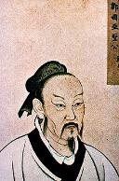
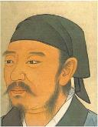
Background: Human nature in Confucian philosophy
Mencius
Organic Metaphors
Four natural “sprouts” of goodness in human nature.
Xunzi
Metaphors of Craftsmanship
It is through the imposition of ritual that we transform our bad natural inclinations.
(See Ivanhoe, 2013, p. 25-26)

Slide 38
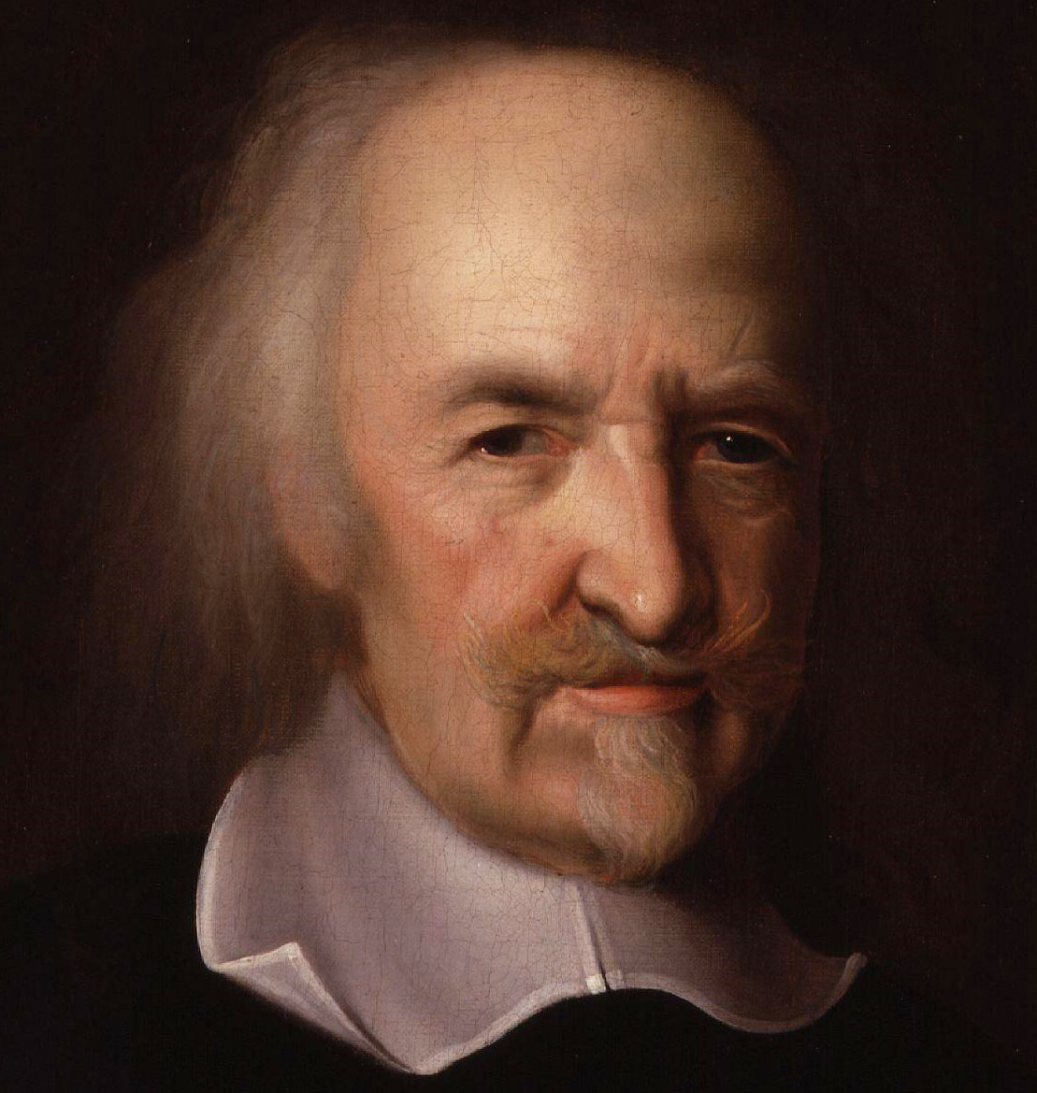
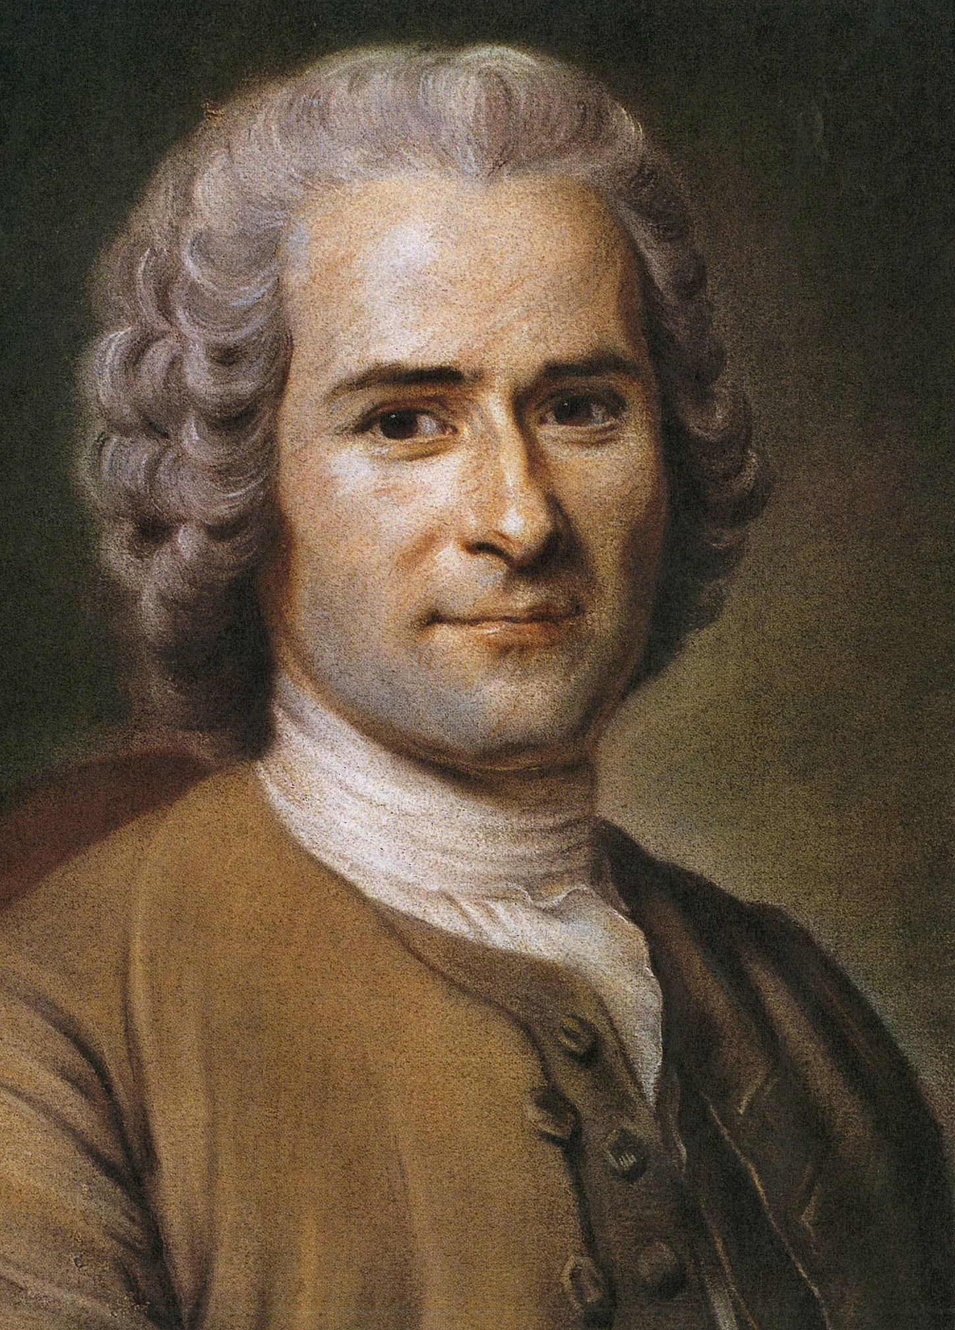
background: Human nature in modern western political philosophy
Hobbes
Human beings by nature are self-interested and aggressive.
Rousseau
Human beings are not naturally war-like, but rather this is the result of civilization. Hobbes’s thus mistakenly thinks that our civilized mode of being was also the case in the state of nature.
In the state of nature life is “nasty, brutish, and short”
Hobbes suggests a powerful state is needed to control humans and bring peace.
Rousseau argues that human beings were peaceful in the state of nature, what is often referred to as the ‘noble savage’.

Slide 39
Central idea of existentialism
Sartre says that the central idea unifying existentialists is the thesis:
“existence precedes essence” (p. 20)
“subjectivity must be our point of departure.” (p. 20)
This reverses the traditional view that sees a human essence preceding existence.
Traditional: Essence → Existence
Existentialist: Existence → Essence

Slide 40


Example: knife maker
As a metaphor for essence, Sartre gives the example of a knife maker. For designed products, the maker has an idea of what he or she is making before the particular objects are made: “production precedes existence” (EH, p. 20)

Slide 41
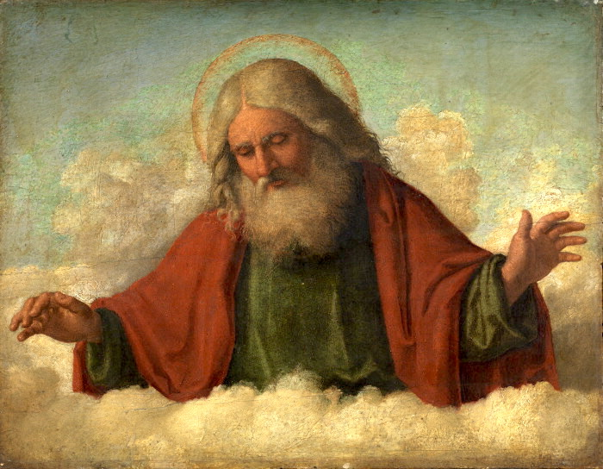


god as “superlative artisan”
“the concept of man, in the mind of God, is comparable to the concept of the paper knife in the mind of the manufacturer: God produces man following certain techniques and a conception, just as the craftsman, following a definition and a technique, produces a paper knife. Each individual man is the realization of a certain concept within the divine intelligence.” (EH, p. 21)
“Man possesses a human nature; this ‘human nature,’ which is the concept of that which is human, is found in all men, which means that each man is a particular example of a universal concept—man.” (EH, p. 22)

Slide 42

Existentialism = No Human Nature
“Atheistic existentialism…states that if God does not exist, there is at least one being in whom existence precedes essence—a being whose existence comes before its essence, a being who exists before he can be defined by any concept of it. That being is man…” (EH, p. 22)
“there is no human nature since there is no god to conceive of it. Man is not only that which he conceives himself to be, but that which he will himself to be, and since he conceives of himself only after he exists, just as he will himself to be after being thrown into existence, man is nothing other than what he makes of himself. This is the first principle of existentialism.” (EH, p. 22)

Slide 43
From human nature to The human condition
Sartre rejects the idea of “human nature” BUT embraces the idea of a “human condition” that structures our existence:
“although it is impossible to find in every man a universal essence that could be said to comprise human nature, there is nonetheless a universal human condition…all limitations that a priori define man’s fundamental situation in the universe.” (p. 42)
The human condition is compatible with acknowledging the distinct historical situations of humanity.
Human Nature
Supplies us with a telos to achieve or normative standards
Human Condition
A priori limitations for human beings

Slide 44

Sartre’s ethic of responsibility (1): “Man is condemned to be free”
“If, however, existence truly does precede essence, man is responsible for what he is. Thus, the first effect of existentialism is to make every man conscious of what he is, and to make him solely responsible for his own existence. And when we say that man is responsible for himself, we do not mean that he is responsible only for his own individuality, but that he is responsible for all men.” (EH, p. 23)
“condemned, because he did not create himself, yet nonetheless free, because once cast into the world, he is responsible for everything he does.” (EH, p. 29)

Slide 45
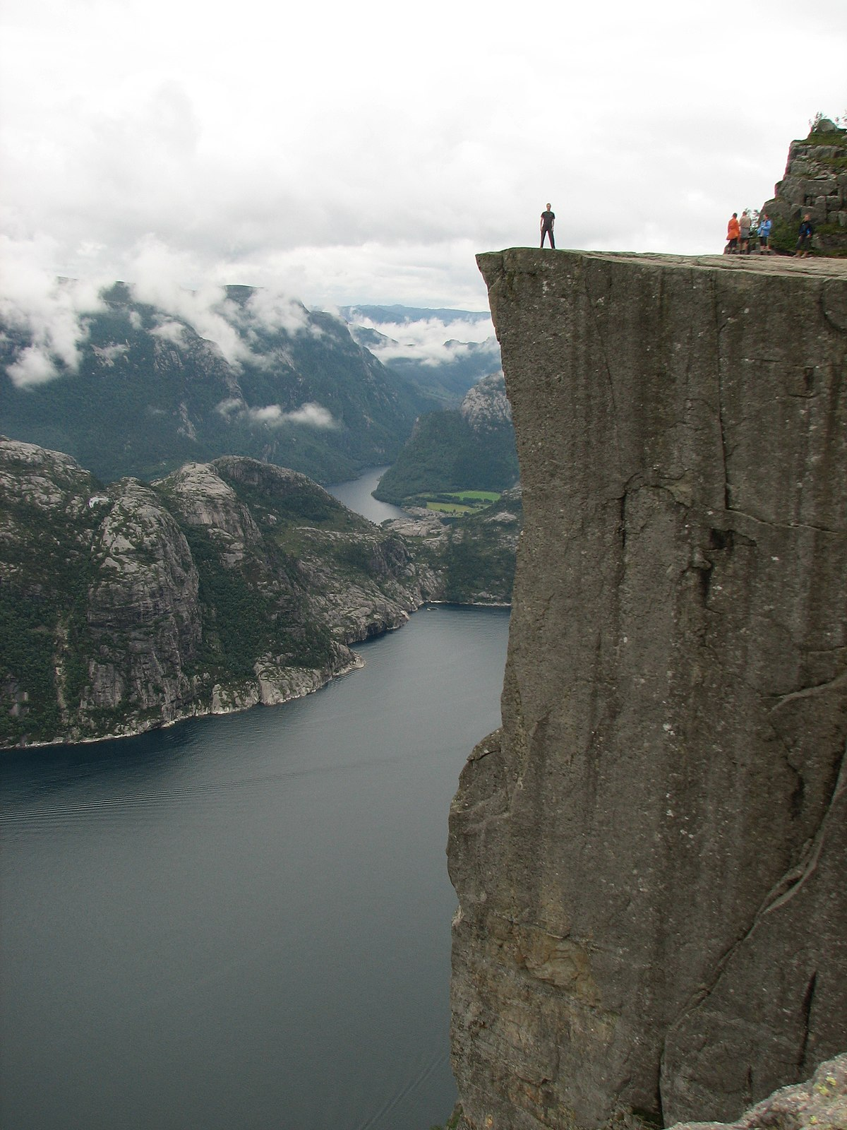

anguish
Sartre distinguishes fear from anguish:
Fear: awareness of a threat in the world.
Anguish: awareness of my own freedom.
Anguish is “consciousness of freedom.” (BN, p. 71)
“Vertigo is anguish to the extent that I am afraid not of falling over the precipice, but of throwing myself over.” (BN, p. 65)
Anguish can concern both the past & the future. Example: the gambler’s resolution.

Slide 46


abandonment
Sartre describes our situation as “abandonment,” i.e., a situation of radical freedom where we have to decide our values.
Example: A boy faces the choice of going off to join the Free French Forces OR staying home with his mother, who would otherwise be alone.
On what basis can he make such a choice?

Slide 47
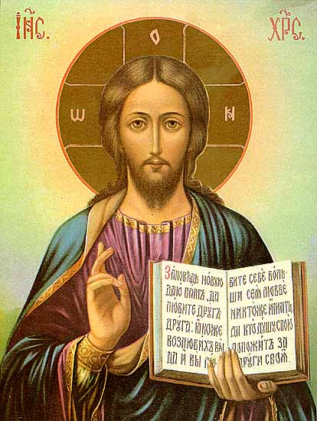
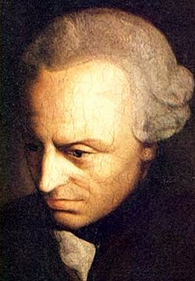
Can religion or philosophy provide an answer?
Love your neighbor as yourself!
According to Sartre, religion and moral philosophy cannot provide an answer to the question facing the young man.
Examples:
Christian: “Love your neighbor!”
Response: Which one? Mother? Fellow Citizens?
Kantian: “Don’t treat others as a means to an end!”
Response: Either I treat my mother as and end & fellow citizens as means OR I treat my fellow citizens as ends and mother as a means.
Treat others as ends in themselves

Slide 48

What about our feelings?
Sartre argues that we cannot find an appropriate guide in our feelings since the value of those feelings depends on whether we let them guide our action. But that is the question we are trying to answer:
“The only way I can measure the strength of this affection is precisely by performing an action that confirms and defines it. However since I am depending on this affection to justify my action, I find myself caught in a vicious circle.” (EH, p. 32)

Slide 49


What about consulting someone?
Sartre argues that consulting another person doesn’t really answer the question because it is up to us to choose whom we consult. Different consultants will give us different answers, and we have to decide whom we will ask:
“But if you consult a priest, for instance, it’s you who has chosen to consult him, and you already know in your heart, more or less, what advice he is likely to give. In other words, to choose one’s adviser is only another way to commit oneself.” (EH, p. 33)

Slide 50
Not choosing isn’t an option
NOT Choosing
We don’t have the option NOT to choose. To not to choose is simply to make a choice without self-awareness:
“I can always choose, but I must also realize that, if I decide not to choose, that still constitutes a choice.” (EH, p. 44)
Choosing

Slide 51

Freedom to choose
In considering moral dilemmas, Sartre insists that at the end of the day, we are simply left with the choice: do or do not.
“You are free, so choose; in other words, invent. No general code of ethics can tell you what you ought to do; there are no signs in this world.” (EH, p. 33)

Slide 52
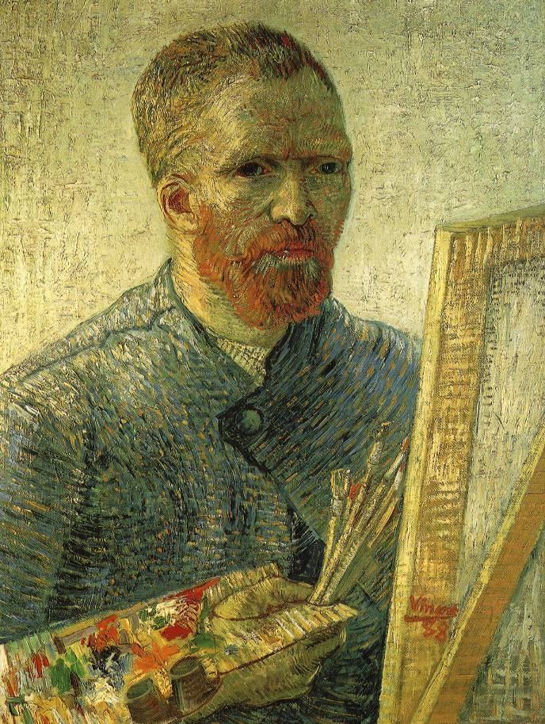
Objection 1: arbitrary choice
Sartre’s answer: the lack of given values to guide one’s choice doesn’t make it arbitrary. It is like creating a work of art.
“Whatever he does, he cannot avoid bearing full responsibility for his situation. He must choose without reference to any preestablished values, but it would be unfair to tax him with capriciousness. Rather, let us say that moral choice is like constructing a work of art” (EH, p. 45)
“What art and morality have in common is creation and invention. We cannot decide a priori what ought to be done” (p. 46)

Slide 53

Objection 2: inability to judge others
Sartre’s Answer: the value of freedom is a criterion by which we can judge others’ choices.
“If we define man’s situation as one of free choice…any man who fabricates some deterministic theory, is operating in bad faith…I call his bad faith an error. Here, we cannot avoid making a judgment of truth. Bad faith is obviously a lie because it is a dissimulation of man’s full freedom of commitment.” (EH, pp. 47-8)
“I cannot set my own freedom as a goal without also setting the freedom of others as a goal.” (EH, p. 49)

Slide 54


Ethic of freedom
Sartre takes up an example derived from George Eliot and Stendhal. He imagines a young girl in love with a boy already engaged to be married. Does she pursue her passion or resign herself to not being with him “in the name of human solidarity” (EH, p. 50)
Sartre’s response:
“One can choose anything, so long as it involves free commitment.” (EH, p. 51)
“The content is always specific; inventiveness is always part of the process. The only thing that counts is whether or not invention is made in the name of freedom.” (EH, p. 50)
Resignation

Slide 55
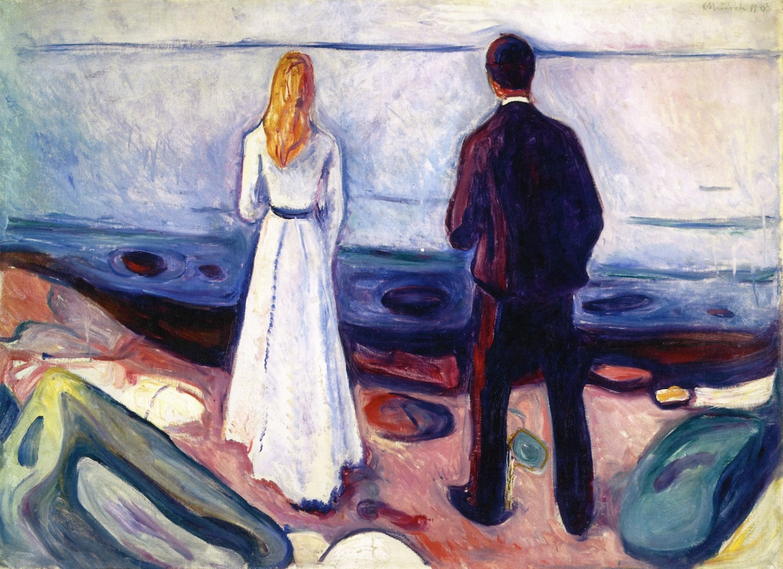
Sartre’s Ethic of responsibility
Sartre holds that when we make choices, we choose for humanity.
“When we say that man chooses himself, not only do we mean that each of us must choose himself, but also that in choosing himself, he is choosing for all men. In fact, in creating the man each of us wills ourselves to be, there is not a single one of our actions that does not at the same time create an image of man as we think he ought to be…If, moreover, existence precedes essence and we will to exist at the same time as we fashion our image, that image is valid for all and for our whole era. Our responsibility…concerns all mankind.” (EH, p. 24)
“I am therefore responsible for myself and for everyone else, and I am fashioning a certain image of man as I choose him to be. In choosing myself, I choose man.” (EH, p. 25)

Slide 56

Objection 3: existentialist values aren’t serious
Sartre’s Reply: existentialist values are serious—they are all we have in a world without God.
“if I have eliminated God the father, there has to be someone to invent values…to say that we invest values means neither more nor less than this: life has no meaning a priori. Life itself is nothing until it is lived, it is we who give it meaning, and value is nothing more than the meaning that we give it.” (p. 51)
Existentialism “is humanism because we remind man that there is no legislator other than himself and that he must, in his abandoned state, make his own choices, and also because we show that it is not by turning inward, but by constantly seeking a goal outside of himself in the form of liberation, or of some special achievement, that man will realize himself as truly human.” (EH, p. 53)

Slide 57
Discussion question for tutorial
Is Sartre’s existentialism ‘philosophy as way of life’?
Consider the various criteria for ‘philosophy as a way of life’ and decide whether elements of Sartre’s existentialism fit.

Slide 58
Bibliography
Barret, W. (1958). Irrational Man: A Study in Existential Philosophy. Anchor Books.
Flynn, T. (2006). Existentialism: A Very Short Introduction. Oxford UP.
Sartre, J.P. (2007). Existentialism as a Humanism, ed. John Kulka. Yale UP.
Sartre, J.P. Being and Nothingness, trans. Hazel Barnes. Washington Square Press.

